Slide 1
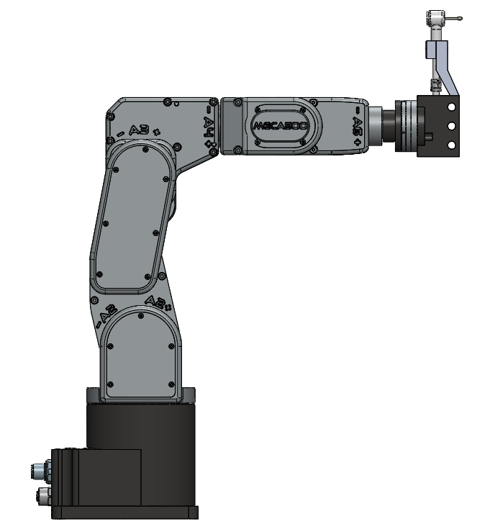

Slide 2
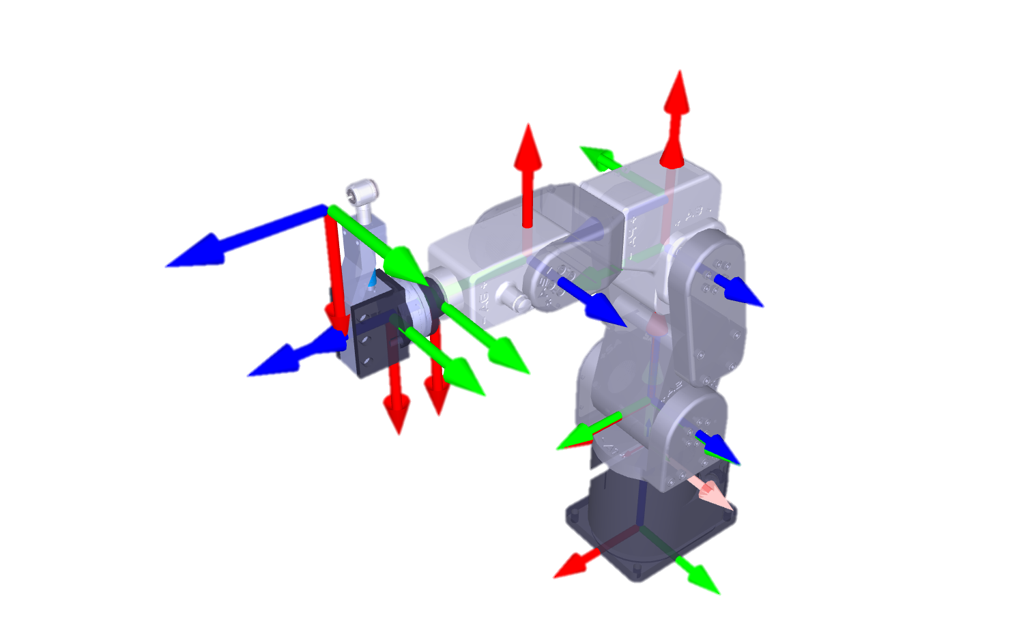

{H}
{4}
{6}
{5}
{3}
{S}
{1},{2}
{0}

Slide 3
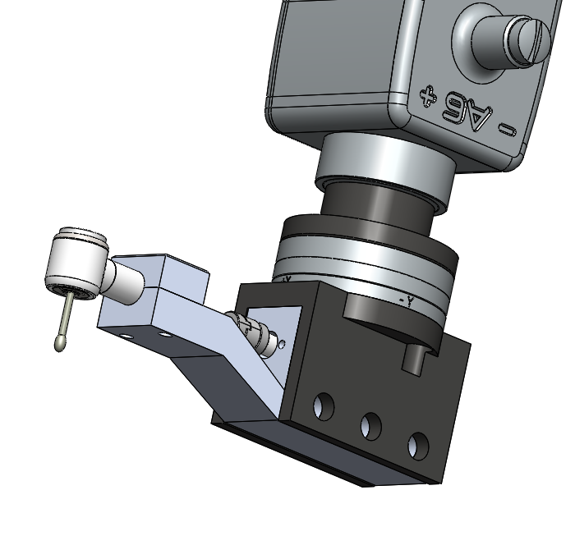

{6}
{H}

Slide 4


{6}
t
{H}

Slide 5
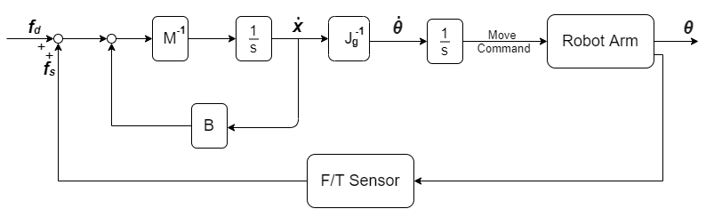
Admittance Control

Slide 6
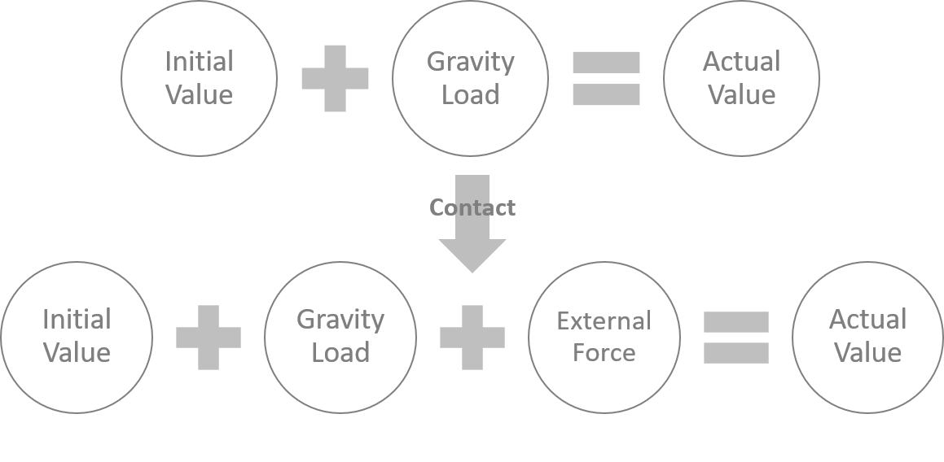

Slide 7
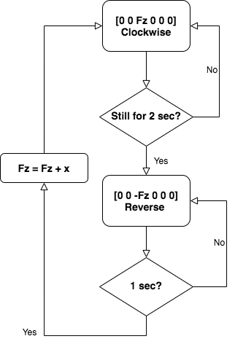
Flow chart
Fz
x
…
t

Slide 8









Same point with different frame
Different point with same frame
F
F
$$r_{p}$$
$$r_{q}$$
p
T
q
p
M
$$\vec{qp}$$
S
T

Slide 9
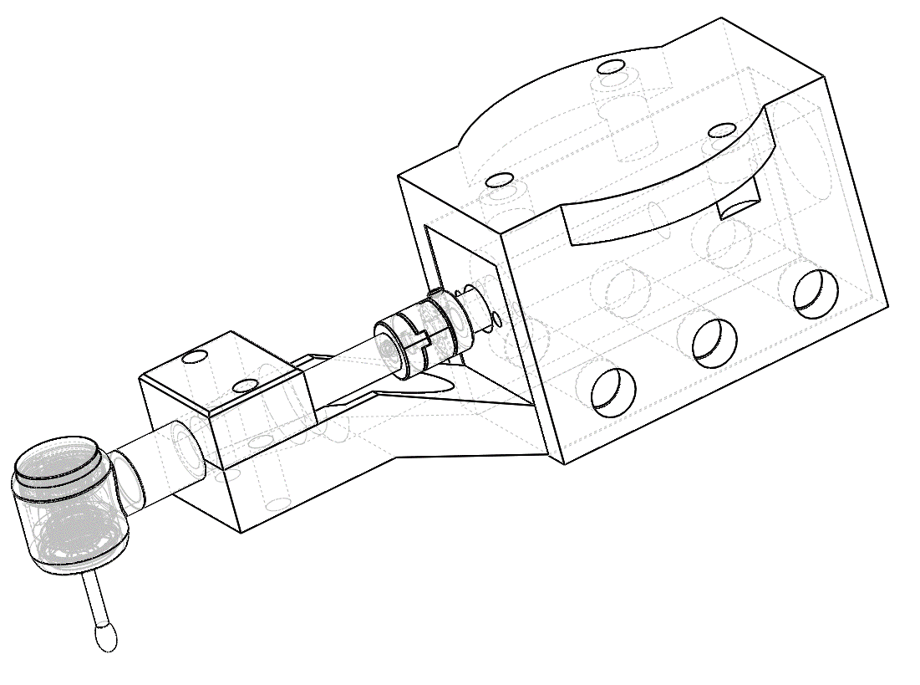


A
$$G_{1}$$
O
$$G_{2}$$
B

Slide 10
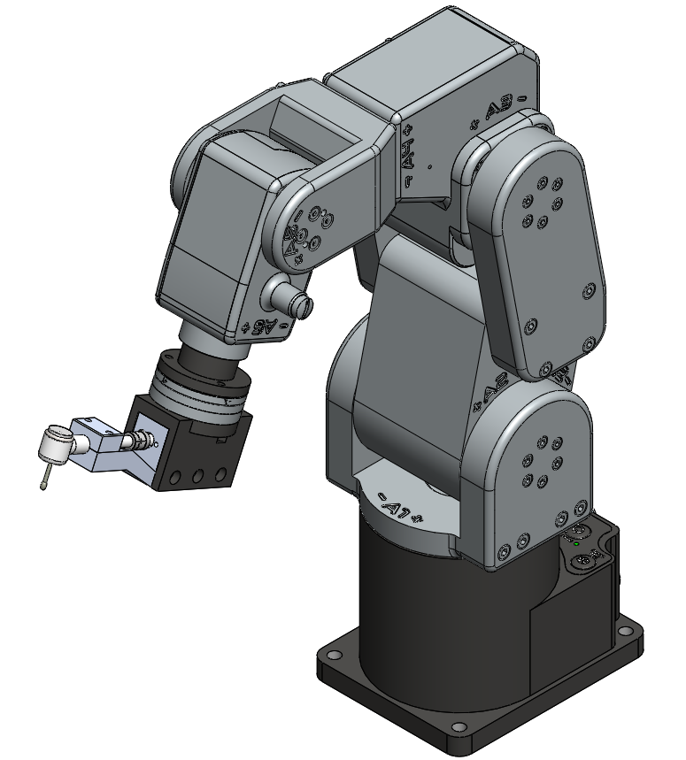
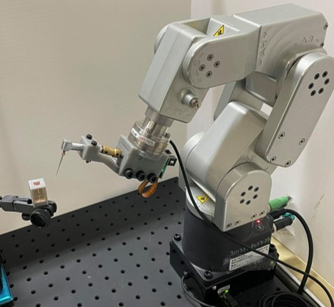

Slide 11


Total length
$$D_{2}$$
$$D_{1}$$
2, 4, 6% Taper
Work length

Slide 12
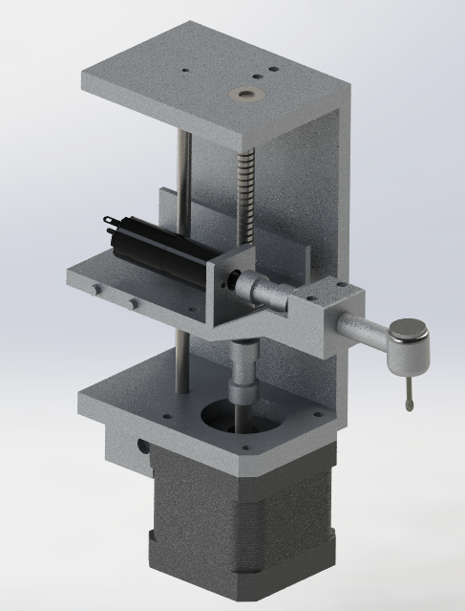
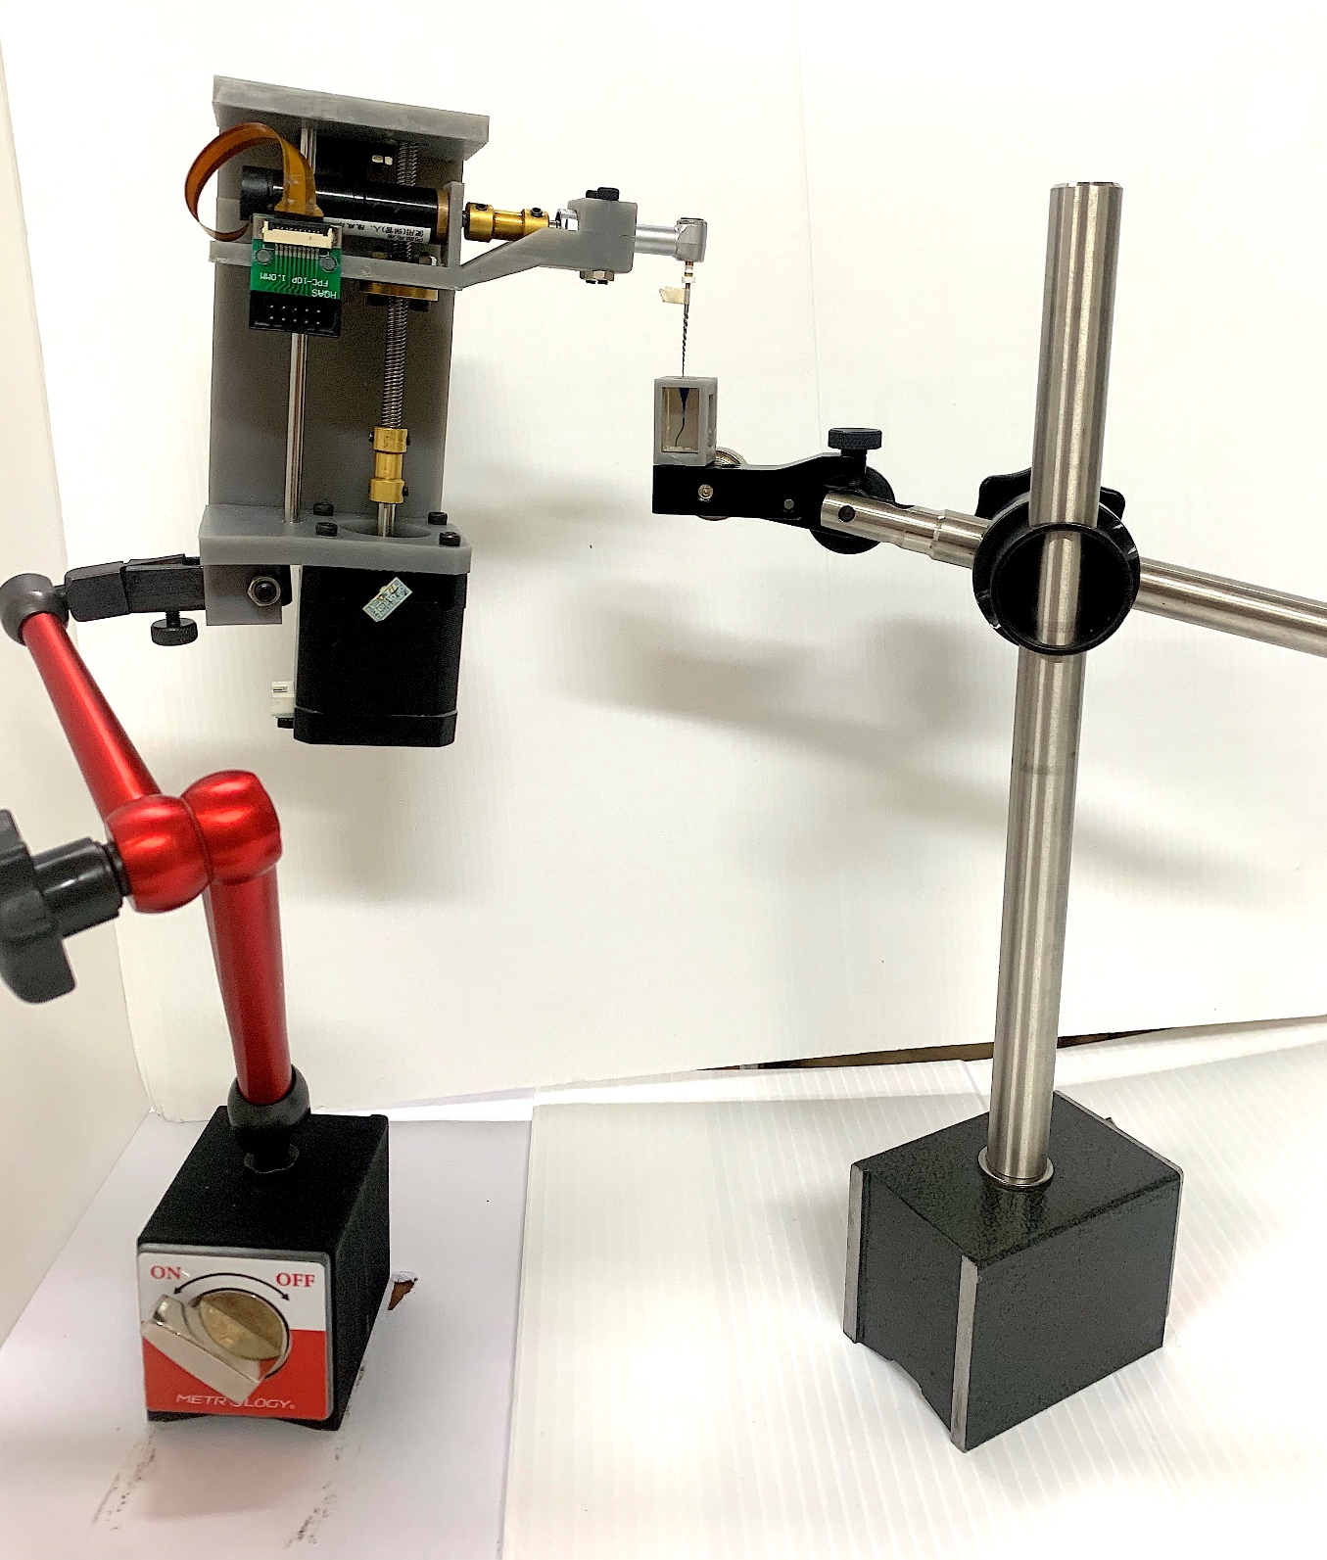

Slide 13
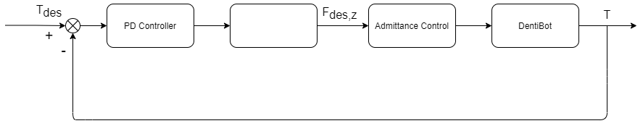

Slide 14




RTOS
EtherCAT
F/T Sensor
Modified Handpiece
Robot Arm

Slide 15
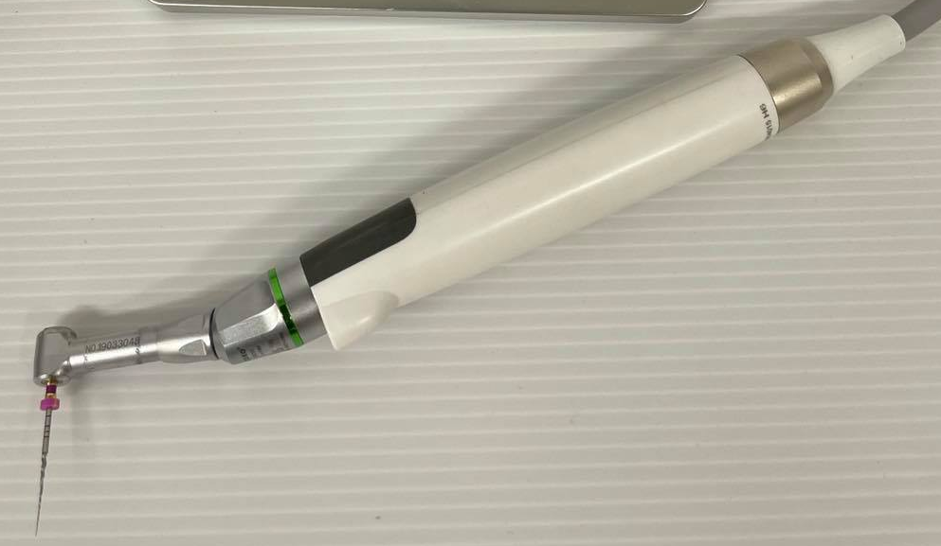
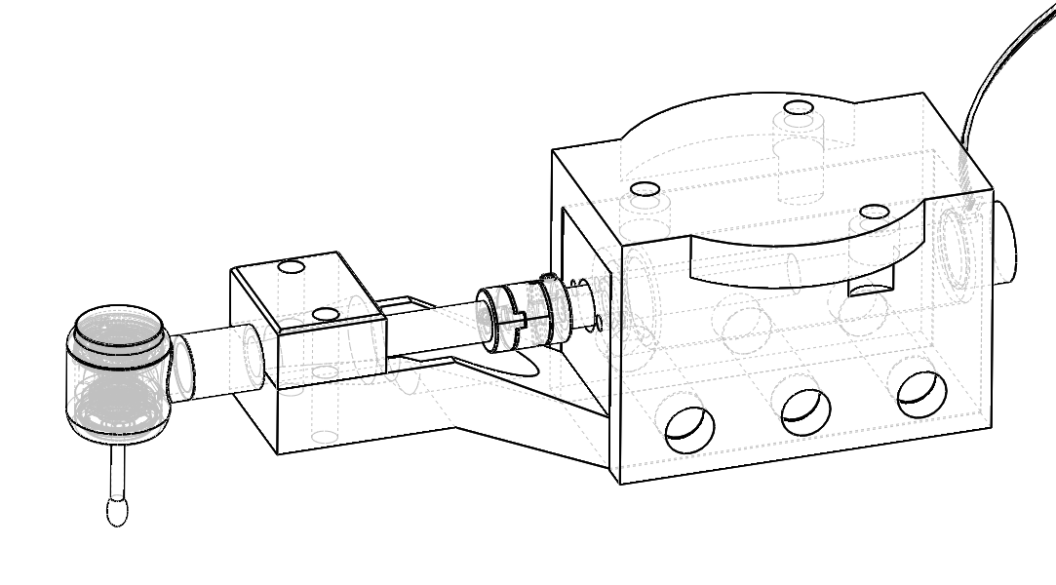

Slide 16
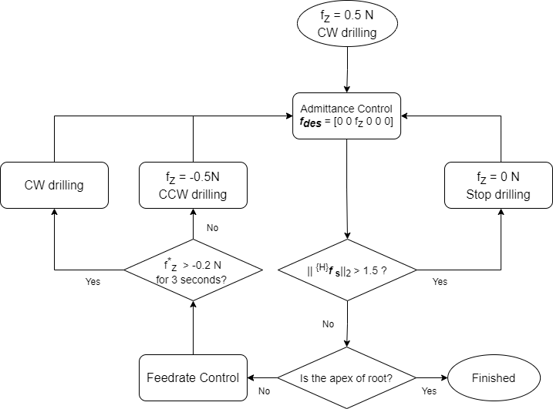
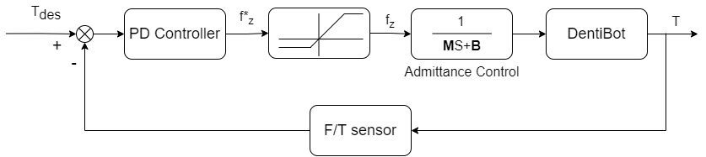

Slide 17
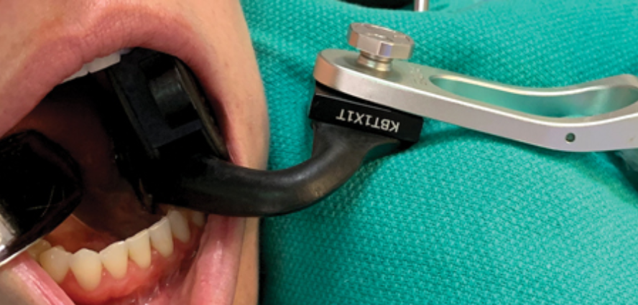
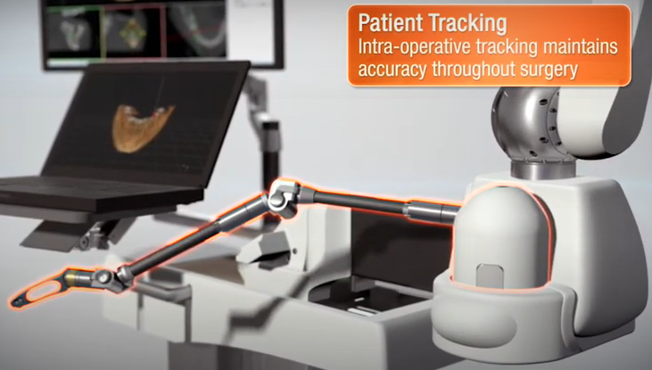

Slide 18
X (mm)
15
3 mm/s
4 mm/s
5 mm/s
6 mm/s
30
55
77
Time (s)
Z (mm)
15
20
45
67
87
Time (s)

Slide 19
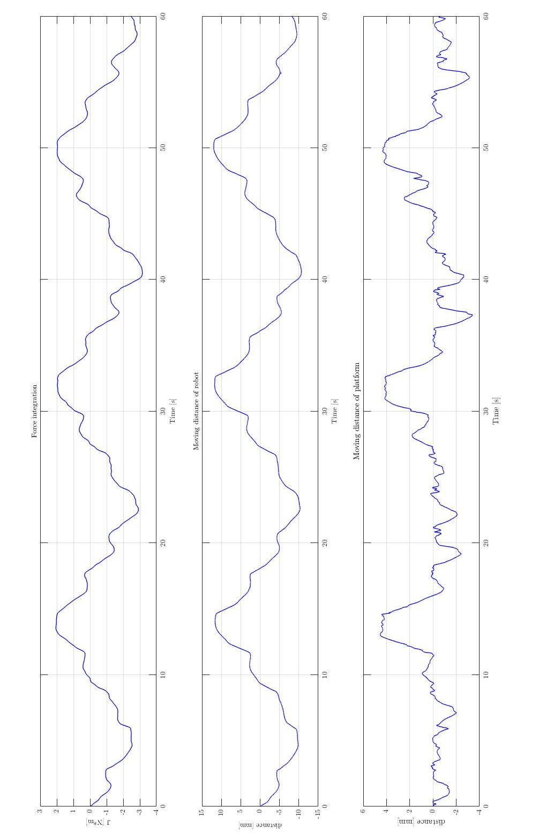

Slide 20
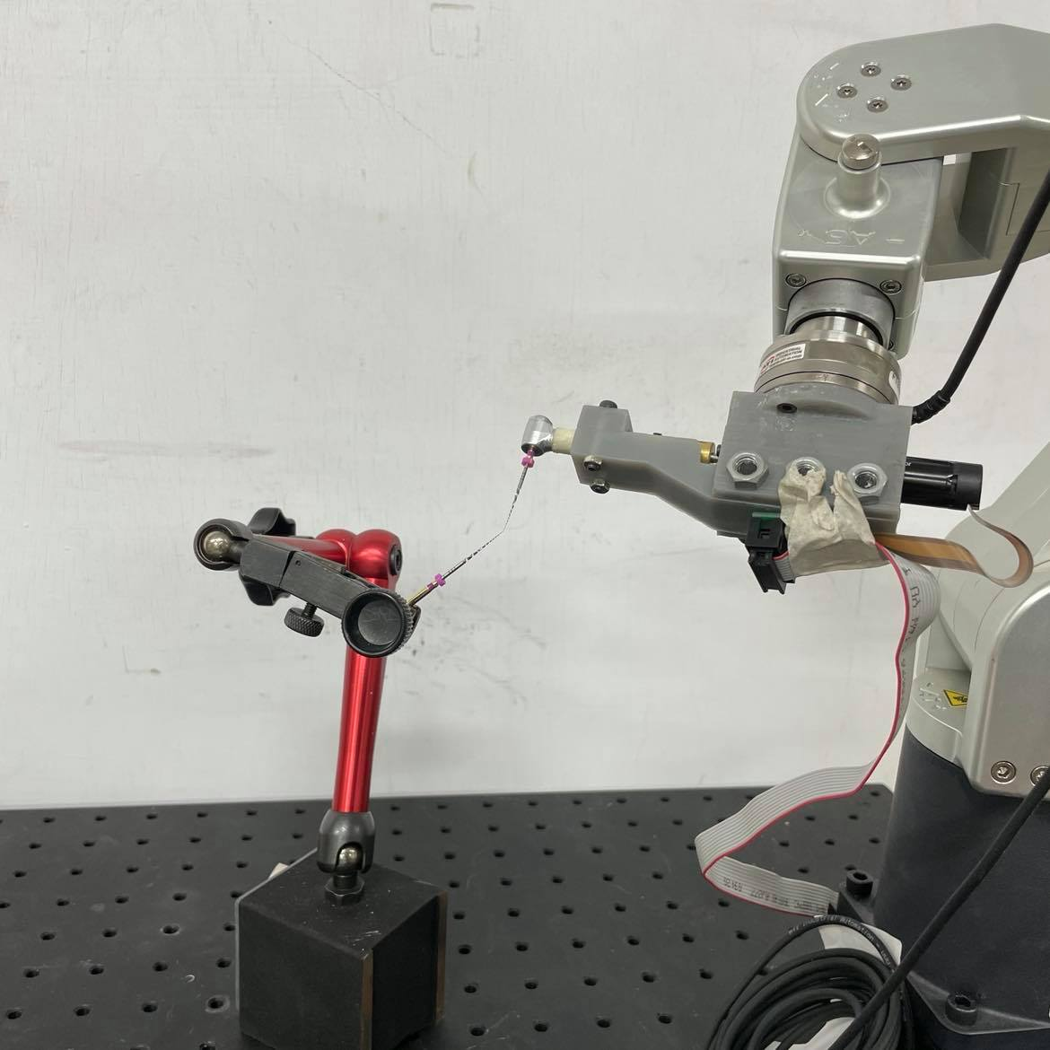
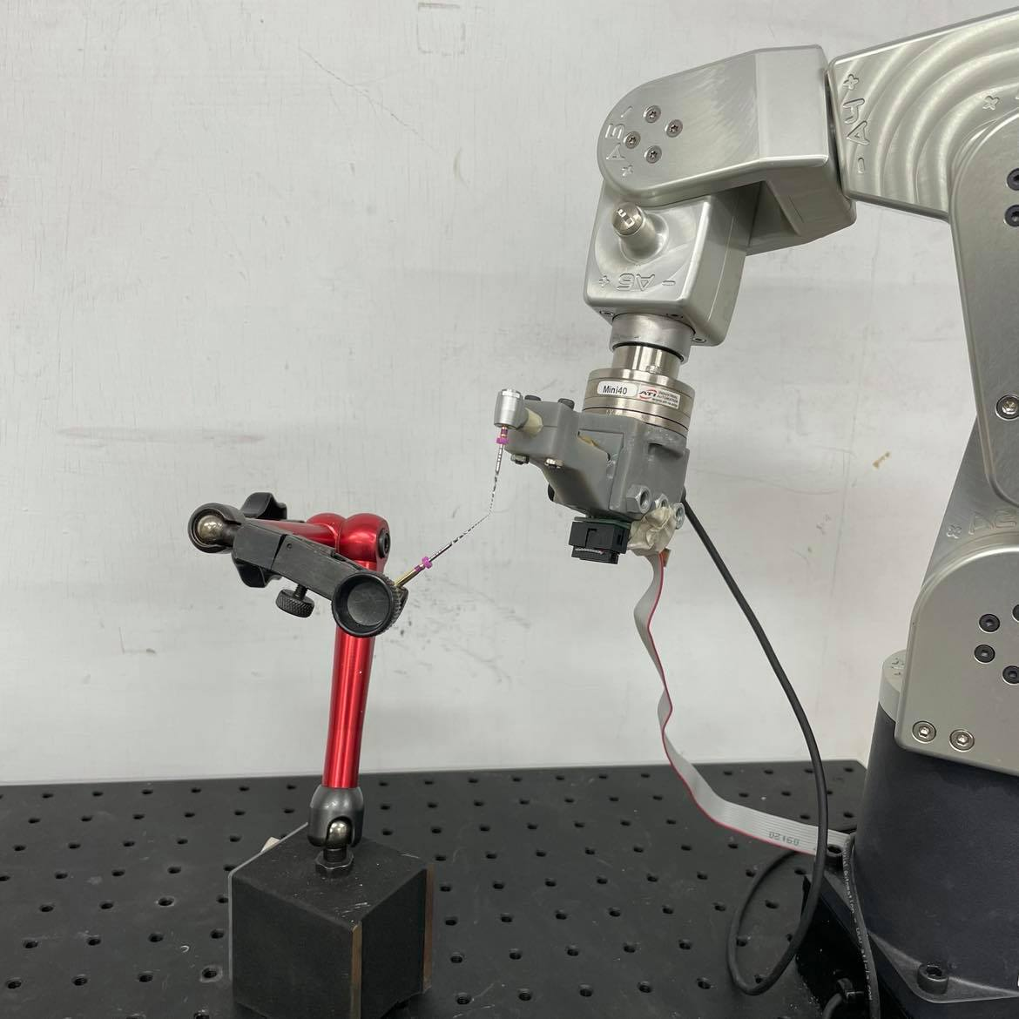
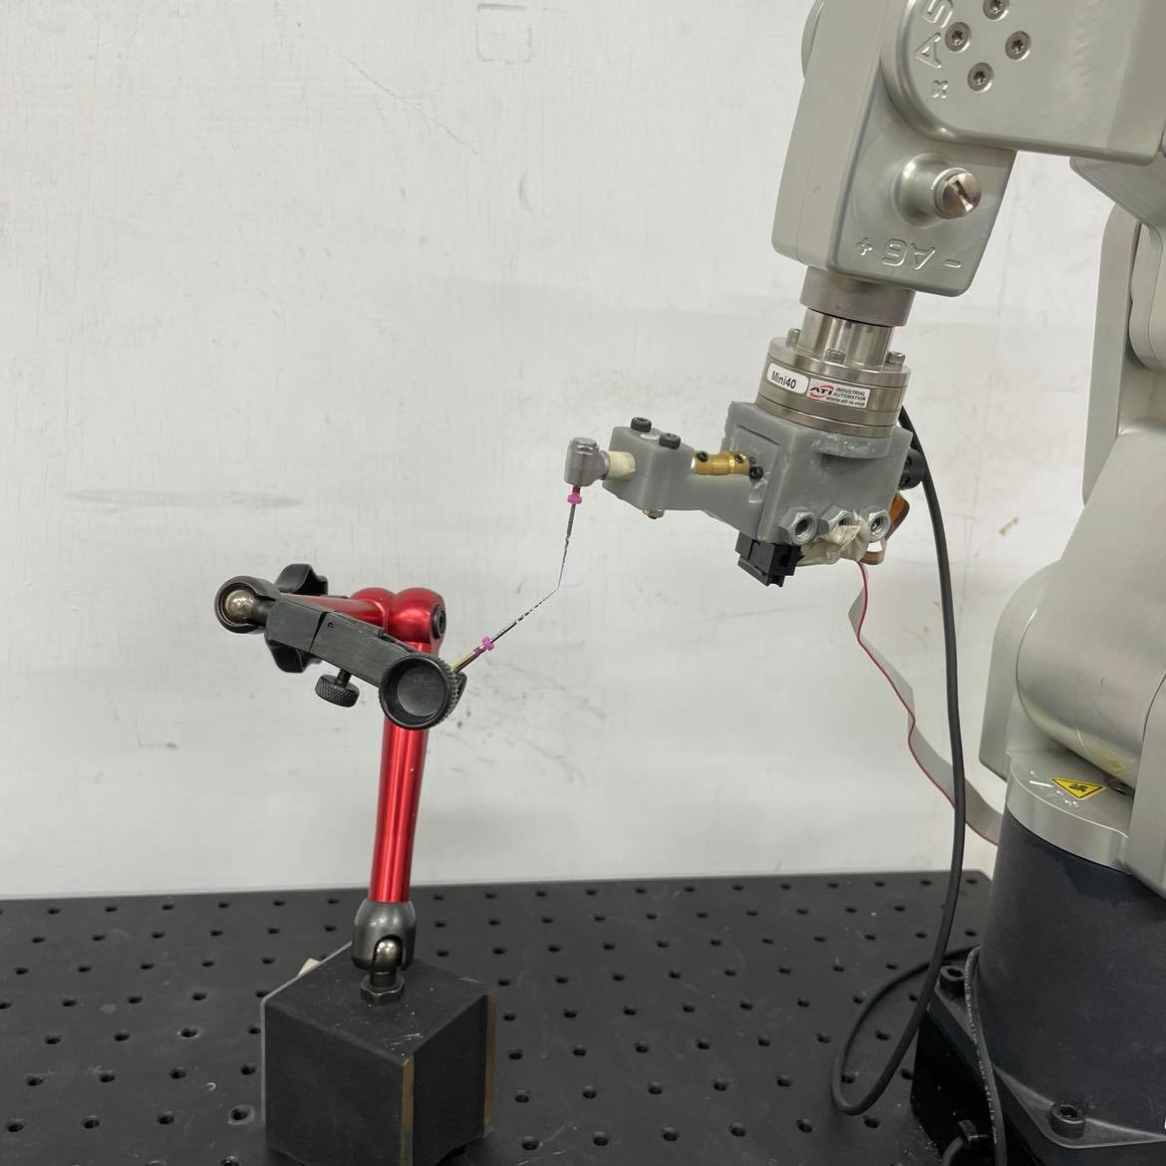
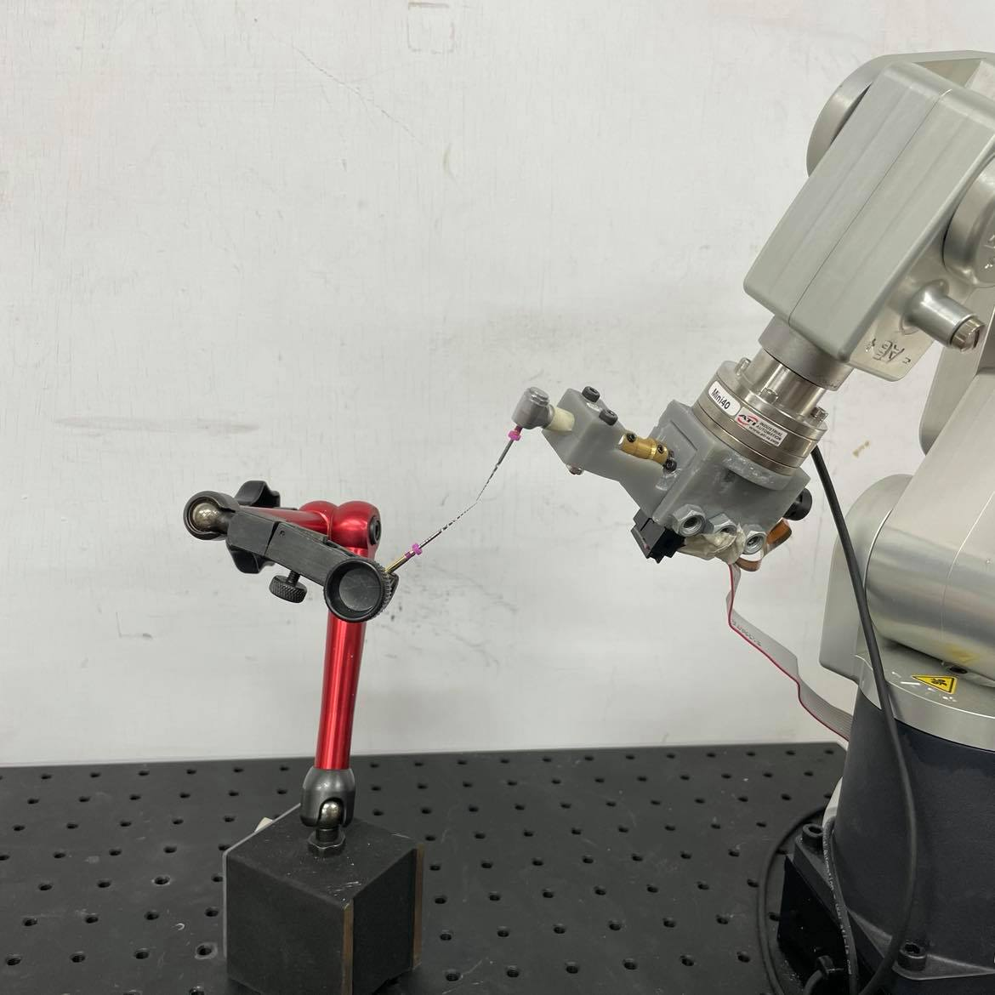
1
2
3
4

